Slide 1


NETWORKING WORKSHOP
Networking for Inuit
Women Entrepreneurs
Inspiring Entrepreneurship for Stronger Inuit Communities

Slide 2
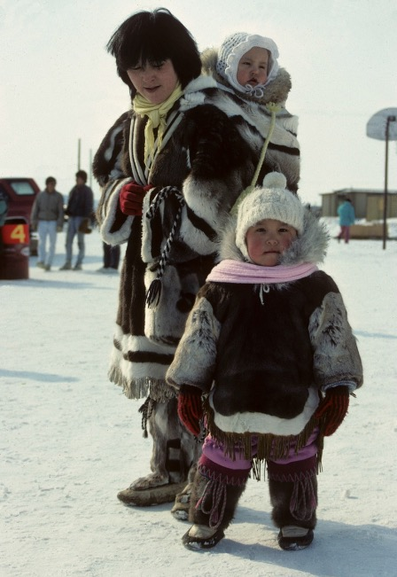


WORKSHIP OUTLINE
01
IMPORTANCE
02
CHALLENGES
03
MAP OUT YOUR CURRENT NETWORK
04
BUILD IT-RELATIONSHIP ACTION PLAN
05
DIFFERENT WAYS: ONLINE, REMOTE, IN-PERSON
06
BUSINESS NETWORK GOALS

Slide 3

Importance of a network
As an entrepreneur building or growing a business, not having a network is like trying to hunt and catch a whale and then harvest it all by yourself: it makes it much easier when you have a community of support to help!
Business peers and mentors
Clients
Partners
Collaborators
Business = relationships, people
Notes:
Say to Group: Some entrepreneurs starting out are lucky and have 1 or 2 or 3 people that support and help them. They came across them organically or by chance as the business (idea) developed and grew and they get comfortable relying on that.. Or we might not have a circle of support at all. As we grow into new roles though, we can’t just rely on the circle of support we had back in the old days. That’s like trying to feed a growing dog the milk it had as a young pup and expecting it to grow. It needs different sources of energy now!
Networking is important your personal growth as business leader, and to your business’ development. Business is about relationships, about the people. By exploring new relationships and surrounding yourself with people who share a similar drive and vision, you are more likely to find potential clients, partners, collaborators, and business peers. It’s also important to have a network of friends and mentors to just draw energy from and keep you going when you’re facing challenges or feeling down or stuck.

Slide 4
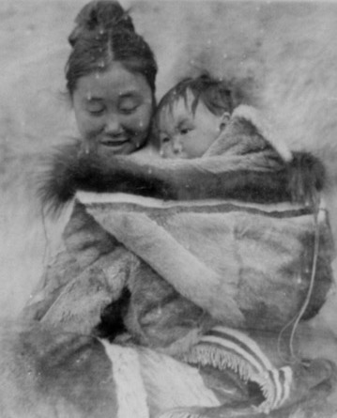
The Challenges
General challenges:
Comfort speaking about yourself
Knowing how to describe your business
Using the ‘relationship first’ approach
Unique challenges to the North:
High costs of travel
Lack of infrastructure
Cultural context
Notes:
Say to Group: there are challenges to networking that all entrepreneurs face, and then those that are particular to a specific context, such as living in the North.
Group Discussion: What are your biggest challenges in networking that you are experiencing already right now? If you don’t yet have a business, what can you imagine they might be for your business?
Note to Deliverer: take what comes out of the discussion and integrate it or add it to the challenges listed on the slide. Go over them one by one:
Say to Group: Many of us feel too shy to share our business vision and challenges with our existing and new networks. Culturally, this might be true for Inuit women, but it is often true for women in general. If we talk too much about ourselves or our business, especially in front of a mixed group: it might feel to much like boasting or seem self-absorbed. Or, in our communities, with the people you know and where everyone knows everyone, some people may have old (maybe even negative but not necessarily) ideas about us. There's a need to reinvent yourself and get people to see the "new you". At the same time, there is a traditional value of community sharing and relying on each other as part of Inuit culture.
If we have a short, clear sentence or two that describe our business and why we do what we do, and we practice saying it, it becomes easier.
Remember: if you don’t share your dreams or vision, no one can get excited about them with you! You will find most people want to help in some way, or be a part of them, even if it is just support. If the people around you aren’t supportive, all the more reason to expand your network to people who do!!
Activity:
Say to Group: Let’s roll up our sleeves and tackle this first group of general challenges - ON NEXT SLIDE

Slide 5
Feeling good about me and what I do!
Write out 3 words that others would use to describe what they value/like in you. e.g. fun, creative, pay attention
Write out WHAT you do in your business and WHY you do it?
i.e. why is it important to you and the people we serve?
AND THEN….PRACTICE!
Notes:
Notes to Deliverer:
Activity: Go through this activity with participants. Tell them that the three positive words that describe their strengths are meant to give them confidence, and be a like a solid rock or positive image they can refer back to always. If it helps, they can repeat these affirmations to themselves everyday as often as they need: I am fun, creative and very good at paying attention to detail! OR: I am great at bringing creativity and attention to my business.
Then they should think about what their business brings to the customer: e.g. my lessons help people understand and value themselves and their culture through learning their language
Then it is really important to have a solid sentence describing their what and why, that they can practice often till it becomes second nature. They can practice it in front of the mirror, with their kids, partner, dog, etc. :)
An example sentence that describes a bit of your qualities as well as the value of what you do might be: “I make families in my community happy by making and delivering very creative, original cakes for their special occasion.
Extension Activity: If time permits, once you’ve practiced with each other in pairs or in front of the group or both, then move to this extension activity.
Say to Group: Now that you are more comfortable speaking about what you do, there is often a next, very difficult step: IF you have something specific you need, to be comfortable to ASK for it. For example: Would you be interested in helping spread the word/inviting some friends/coming to my event? OR Do you know of someone who can…? OR Are you interested in trying it out..? A very important point: If we don’t ask: we can’t receive!! And when you ask something, remember it’s nice to offer something in return.
Now have them try practicing that together if time permits or if appropriate.

Slide 6

Further challenges in the North
How can we build networks with:
High costs of travel
Lack of technology and infrastructure (access to internet, etc)
Cultural context
Language barriers and regional dialects
Lack of child-care and family responsibilities
Life responsibilities and challenges
Notes:
Say to Group: there are challenges particular to the North that you have all experienced to some degree.
Discussion: Let’s share some ideas of how to overcome these challenges. Answers might be: relying more on family; rotating childcare with someone in your network/family, use the local radio if no internet,
Perhaps bring to the discussion if it’s not raised: Are there possibly proactive ways to combine the expensive travel you have to do for other reasons with networking and building relationships?If it helps give examples of overcoming any one of the challenges listed from the IWBN profiles:
Uasau Soap: “I see now that selling Mary Kay prepared me for Uasau Soap. It was very hard for me to accept money from people even though they wanted the product. I had to learn to accept the money, to keep stock, to take orders. Mary Kay sells itself so I’ve never had to push the product; also took the Kamik making program and was in an anaana and me sewing group
Uvvautik Soap Factor:To be able to experiment with this, our teacher presented our project to Brighter Future program. It has been accepted by the mayor and councilors of our community
Hilda Bloomfield: Over time, she also realized that doing business face-to-face and on a personal level works the best. For example, a funder was unwilling to help until she travelled to their offices and had a meeting with them. She got a funding commitment the same day. As she says, “The personal relationship is the key – let them know who you are and what you are like.”

Slide 7

What is your current network?
Who around you who is part of your network?
Personal friends and family
People you run into everyday (businesses, school, work)
People in the community who you may not know well but who you recognize
People in on-line communities
Who else?
Activity: Map it
Notes:
Notes to Deliverer:
Give participants 5-10 minutes to work on this activity. If there is time, they can share their maps with the group.

Slide 8
Build your network relationships
What types of relationships do you want to build?
List them.
Where and how will you find them?
How can you give back to or serve these people for their help or participation?
Notes:
Notes to Deliverer: Have the participants fill in this chart on their own note paper.
Say to Group: Think toward the business you want to build: what do you and the business need? Think toward the kinds of people you want to attract to it, and list them. Then think of where each of those people might be found and how. Then, remember that relationships are a two-way street: How can you help each other, or what can you help each relationship with in turn? (i.e. what kind of mutual relationship can you build)?

Slide 9
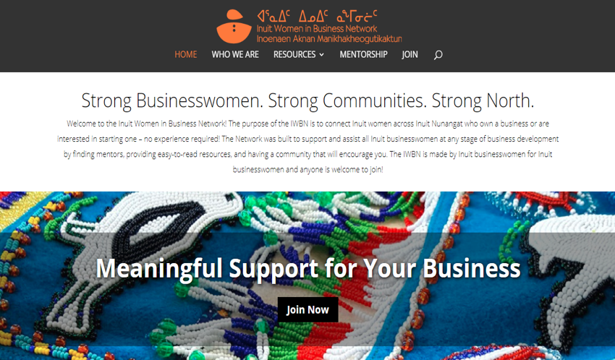
The iWBN is a great place to start!
Notes:
Say to Group: Here is a very powerful resource that has been developed right here by and for you as Inuit women entrepreneurs. The Inuit Women in Business NEtwork is a member-based network with strong brand that was developed out of research about needs and challenges facing Inuit business women

Slide 10

How can the iWBN help you?
Provides a toolkit with resources on banking, funding programs, and the use of social media and mentorship
Monthly informational newsletters
An advisory committee of Nunavut business development organizations that provides culturally relevant guidance and support
Connects Inuit women across Canada, in Inuit Nunangat as well as urban centres
Notes:
Say to group: 2011 research showed that Inuit women, while having a strong entrepreneurial spirit, have had challenges building business because of a lack of strong business peer support. The IWBN was formed as a pilot project with their goal being to provide a network for Inuit women entrepreneurs to share support, guidance, experience and resources

Slide 11
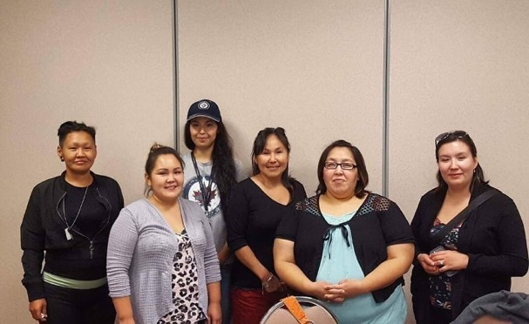
Your relationship action plan (R.A.P.)
Review your notes and thoughts from the workshop and discussion.
Three action items toward building your network
Why you’ve chosen those actions in particular
When you want to do them
Who will check in to make sure you’ve done them
Notes:
Say to Group: Let’s put all your thinking around this into a plan. Look at the notes you’ve already taken. Think about the things you’ve discussed during this workshop.
Notes to Deliverer: have participants write out 3 action steps (with the further details as outlined above) that they can take starting soon (tomorrow, next week), to begin actively building your network. Participants can share once they’ve written them down.

Slide 12

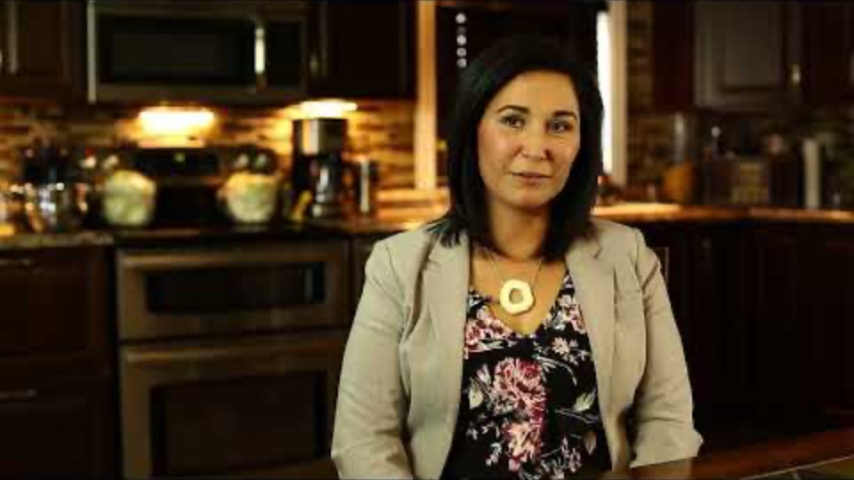
Inuit Women’s Business Network
www.pauktuutit.ca/iwbn
RESOURCES
© Credit: Ilkka Koivula

Slide 13
QUJANNAMIIK
THANK YOU!
Inspiring Entrepreneurship
for Stronger Inuit Communities

