Slide 1


MONEY MANAGEMENT
Money Management for
Inuit Women Entrepreneurs
Inspiring Entrepreneurship for Stronger Inuit Communities

Slide 2

WHAT ARE THE BENEFITS OF GAINING FINANCIAL SKILLS?
Be confident that you can manage your finances
Reduce stress be more independent
Be a smarter consumer
Achieve your life goals
Provide for yourself and your family
Control your financial future
Notes:
Whether your goal is to get out of debt, to balance your budget or to start your own business, setting a financial goal and making a plan can help get you there.

Slide 3


WHAT IS THE DIFFERENCE BETWEEN A WANT AND A NEED?
NEEDS
WANTS
The essentials required for everyday business
Example: fabric materials,supplies, ingredients, internet
Things that aren’t required immediately
Example: mannequin, electronics, mixer
Notes:
Notes: it’s easy to feel confused when deciding how best to use funds. It’s important to decide what is really necessary to do business and what can wait until revenue comes in. For example, do you need to spend money on a website or is a Facebook page enough to get started? Do you need a storefront or can you sell online, in someone else’s shop or through friends and family? Furniture, software, swag, are all things to consider when you are starting out. Cash flow is critical to a business surviving so it’s important to always be asking what is absolutely necessary to bring in revenue at a faster rate than it is going out.

Slide 4
What are your last five purchases?
Write down the last 5 items you have purchased?
Are the items on your list wants or needs?
Notes:
Discussion: Write down the last 5 items you have purchased?
Are the items on your list wants or needs?

Slide 5
Where to find money to start your business?
What personal monies can you realistically put into your business for both to start-up and on-going?
Are family members or friends willing to give you a loan/gift/investment?
Crowd-sourcing?
Other monies available in your community or from the bank or government? Often special funds or grants are available for specific groups-North, women, certain industries, etc.
Notes:
Say to Group: look at the first point:
Start-up money: often when we think about finding the money to start our business or expand it, we limit our thinking. It is helpful to do lots of research, talk a lot to your networks (use those social resources!) to have a realistic idea of all the opportunities for funding out there.

Slide 6

How comfortable are you with banking?
What do I need to know?
Keep your personal and business bank account separate. This will help you stay organized and in control
Establish a relationship with your bank. They will help you know what services are best for your situation
Notes:
Say to Group: Many people are unfamiliar with all the ways the bank can help. Sharing information, answering questions, providing support.
Discussion: what experiences you’ve had?
Discussion: Make sure you have the right account for the amount of business you are doing: will you be making over $30K a year? If so, you’ll need a business account, which costs a little money but allows you to track your business expenses much easier than if they are mixed with your personal account.
If you bank online and would like to establish a relationship with a banker, call or email asking what they would suggest.

Slide 7

Budgeting
A picture of all the money you are making and spending.
Why is making a budget important?
A budget is a snapshot that will help you:
See what and where you spend
See where and how much money making
Know if you have a profit or loss
Notes:
Say to Group: Most people have a good idea of what their income is. Simply add up the money you make from a job and any other money that you have coming in. If your income is irregular, try to calculate a monthly average.
When your income changes from month to month, it’s especially important to keep your budget up to date. This lets you know your financial position and make adjustments when you need to.
*You may have a variety of part-time jobs or income from self-employment, bursaries, grants, etc. Keep records of your income from all sources. Try to estimate the approximate total from all sources of income for a typical month.

Slide 8
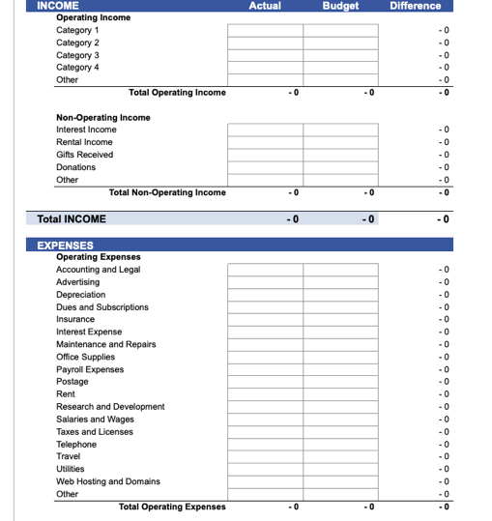
How to start?
The first step in managing your money is knowing what’s coming in and where it’s going out — and making sure the “in” is more than the “out” so you have enough for your needs, and can save and invest for your future.
Notes:
Discuss some different ideas of where money comes from and where it goes out for a business.

Slide 9

How does budgeting work?
Budgeting doesn’t mean doing without. It’s just an organized way to manage your money.
Revenue-add up all your income
Expenses-add up everything you spend
Balance-the difference between revenue and expenses
Formula
Revenue – Expenses = Balance
Notes:
Say to Group: When you think about budgeting, it’s important to look beyond balancing expenses against income in the short term. Be sure to include savings for an emergency fund and for future needs like ongoing education, mortgage, etc.
Savings should always be part of your budget. Small savings add up fast and can be there for emergencies or unexpected expenses.

Slide 10

Types of expenses
Income and expenses can be fixed, variable or irregular
Fixed- the amount is the same every month
Variable-the amount changes every month
Irregular-the amount only happens sometimes
Notes:
Activity: In your notebook or on handout, begin to identify what are fixed variable or irregular expenses.

Slide 11
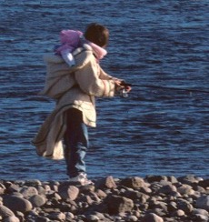
Let’s practice!
Example:
Neevee is married and has 2 young kids. She wants to start her own business.
She needs to make a budget for her family to see if there is extra money she can use to start her business.
Notes:
Brainstorm some ways to make extra income or find ways to save in your family budget to save for your business.

Slide 12
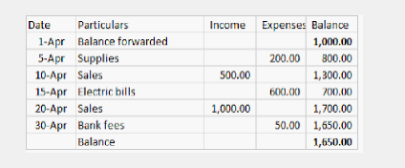
Bookeeping
Bookkeeping means keeping a record of all money going in and out for your business.
Two main documents:
Cash Flow - a record that shows loss or profit on an ongoing basis, so you can project-based on budget
Record of Transactions - a record of all money coming in to and leaving your business daily
Pro Tip: Stay ORGANIZED
Notes:
Activity: Using a worksheet handout, practice filling out a cash flow and record of transactions sheet.

Slide 13

Cash flow is key
Cash flow is necessary:
For your business plan
To plan an estimate for revenues and expenses for your business in the upcoming year
To manage inventory supplies
Pro Tip: Do a Cash Flow Statement monthly, to keep track of your cash position.
Notes:
Activity idea. Use the Business budgeting and cash flow worksheet at:
https://www.futurpreneur.ca/en/resources/operational-and-financial-planning/financial-templates/the-cash-flow-basics/
or create a simple worksheet to practice with.

Slide 14

Record of transactions
The details of every transaction of your business. Making sure you keep detailed records will help you stay on track.
Record every:
Sale
Purchase
Grant
Loan
Time your business makes or spends money
Notes:
Activity idea. Use the Business budgeting and cash flow worksheet at:
https://www.futurpreneur.ca/en/resources/operational-and-financial-planning/financial-templates/the-cash-flow-basics/
or create a simple worksheet to practice with.

Slide 15

Staying organized
Ways to stay on top of it all:
Create binders that include blank cash flow statements and records of transactions
Compare to your bank statements regularly
Get help from a bookkeeper or accountant in your area
REMEMBER YOU’VE GOT THIS!
Notes:
Handouts of cash flow statements and records of transactions to practice with.

Slide 16

Futurepreneur
futurpreneur.ca/en/resources/operational-and-financial-planning/financial-templates/the-cash-flow-basics/
Mentorship
pauktuutit.ca/social-and-economic-development/economic-independence/mentorship-inuit-women/
Let’s Talk Money
pauktuutit.ca/iwbn/lets-talk-money/
Futurpreneur Canada
www.futurpreneur.ca
Financial Institutions
TD Economics: Aboriginal Business Increasingly Embracing Innovation
TD Economics: The Long and Winding Road Towards Aboriginal Economic Prosperity
Credit Union Central: Deepening Relationships: Credit Union and Aboriginal Peoples Case Studies
RESOURCES
© Credit: Ilkka Koivula

Slide 17



QUJANNAMIIK
THANK YOU!
Inspiring Entrepreneurship
for Stronger Inuit Communities

